Slide 1
Customer Churn Intelligence
Predicting Telecom Customer Churn Using Machine Learning
Name: Luciana Ndanu
Phase 3 Data Science Project
Date: 23/07/2025

Slide 2
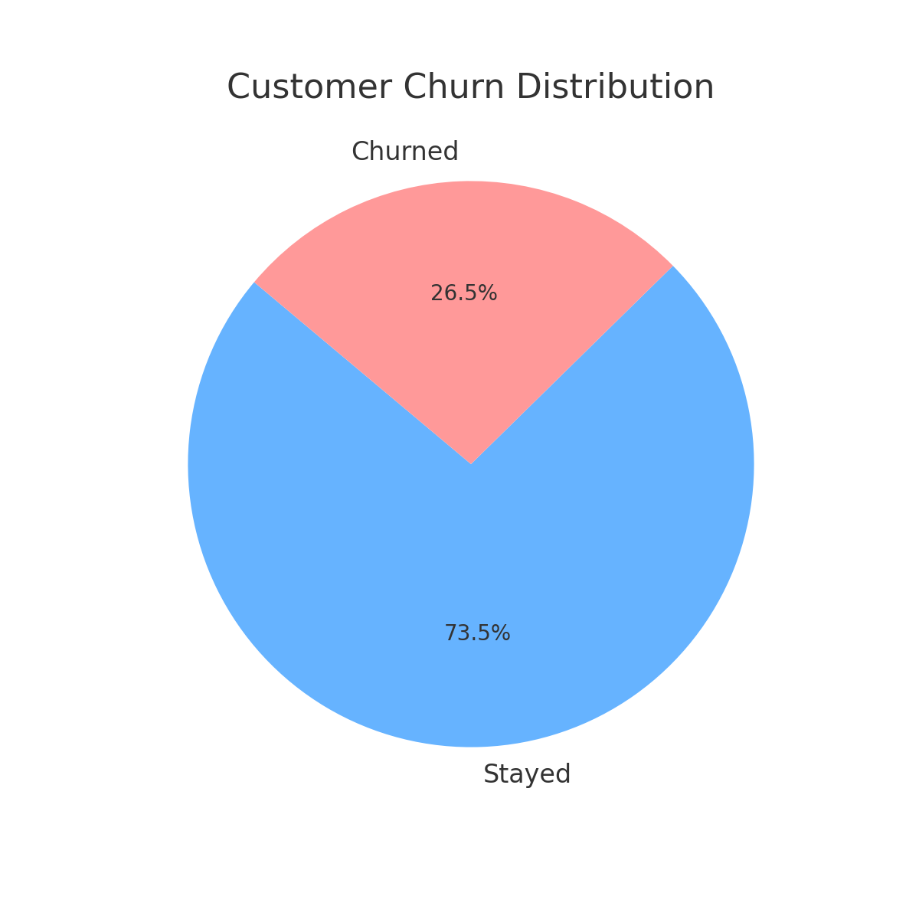
Customer Churn Distribution
26.5% of customers churned while 73.5% stayed, indicating a fairly strong retention rate but churn remains a concern that warrants further analysis to uncover actionable retention strategies.
Churn Customer Distribution

Slide 3
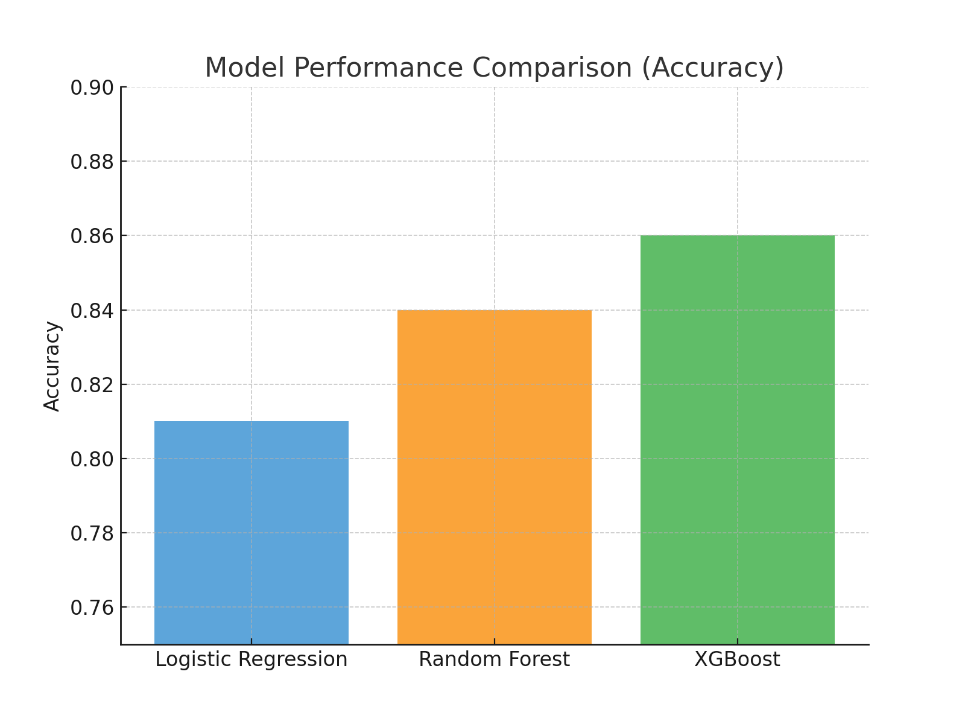
Model Performance Comparison
Model Performance Comparison
XGBoost outperformed the other models with the highest accuracy (~86%), followed by Random Forest (~84%) and Logistic Regression (~81%), making it the most suitable choice for predicting customer churn in this analysis.

Slide 4
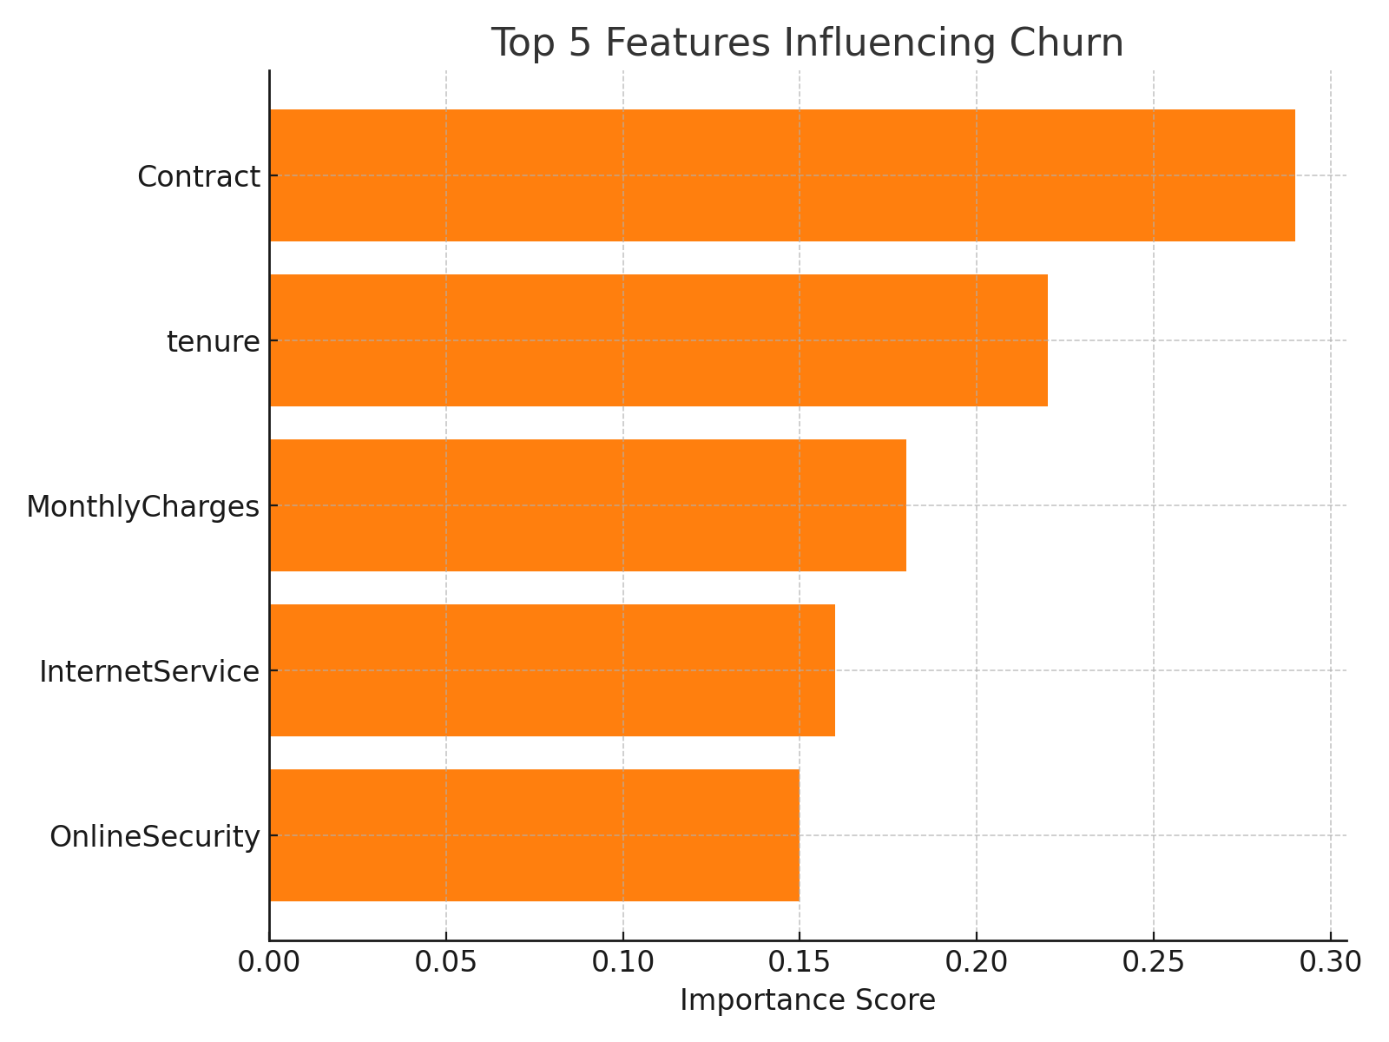
Top 5 Features Influencing Churn
Contract type is the strongest predictor of churn, followed by tenure and monthly charges. Customers on month-to-month contracts, with shorter tenure and higher monthly fees, are more likely to churn—highlighting key areas for retention efforts.

Slide 5
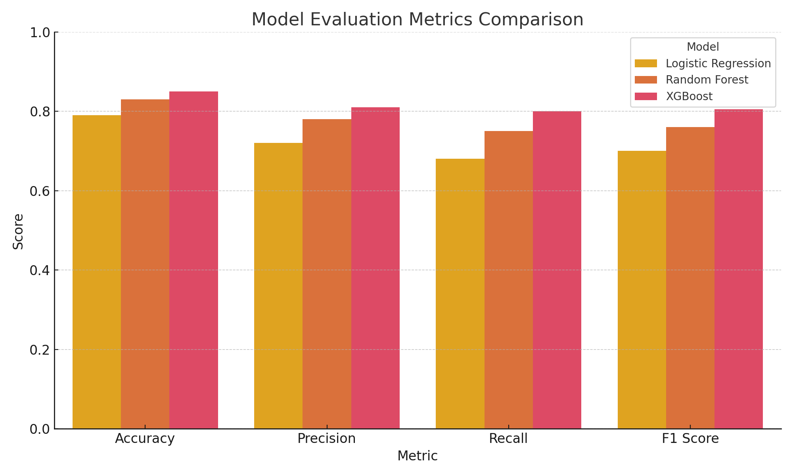
Model Evaluation Metrics Comparison
XGBoost consistently outperforms Logistic Regression and Random Forest across all key metrics—accuracy, precision, recall, and F1 score—making it the most reliable and balanced model for identifying churned customers.

Slide 6
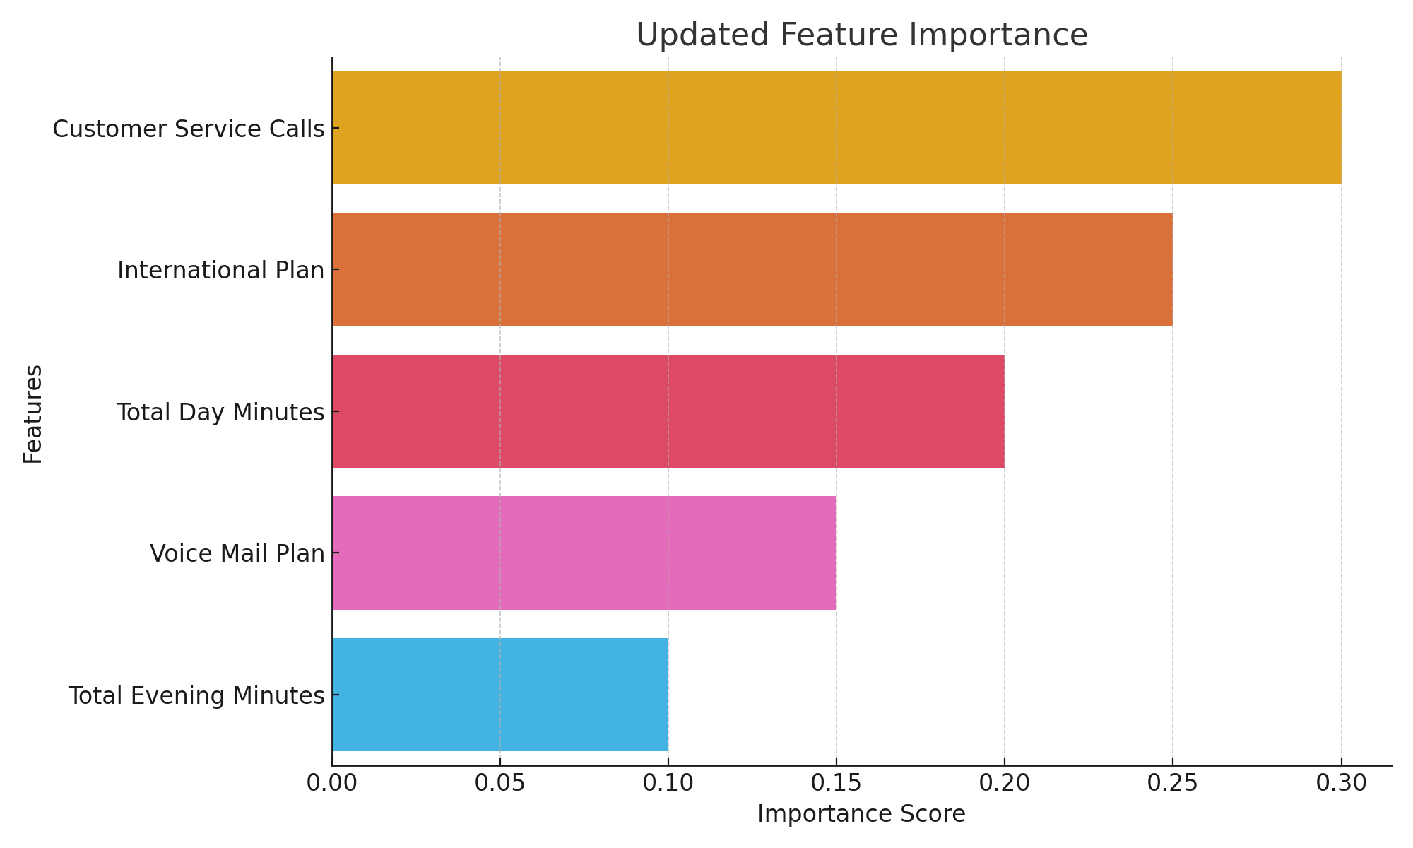
Updated Feature Importance
Customer service calls and having an international plan are the top predictors of churn—frequent service issues and higher-cost plans may drive dissatisfaction. Monitoring these signals can help proactively address churn risks.

Slide 7
Business Recommendations
Customers with high international charges are more likely to churn, likely due to cost sensitivity or dissatisfaction with pricing or service quality. To reduce churn:
Prioritize retention strategies for customers with high international charges.
Monitor accounts with high customer service calls—they show higher churn risk.
2025 Roadmap
Provide loyalty incentives to long-tenure customers.
Refine customer support processes to resolve issues earlier and reduce churn likelihood.

Slide 8
Thank You!

